Slide 1


How to Use this Presentation
Present with ease and wow your audience
Customize with text and photos.
Add elements from the library or upload from your drive.
Apply page animations and transitions to emphasize ideas.
Use point forms and short sentences instate of long paragraphs
Use the PLP pitch deck guide and follow the protocol on slides
Lastly “PLEASE DELETE THIS SLIDE WHEN YOU ARE DONE!”
02

Slide 2


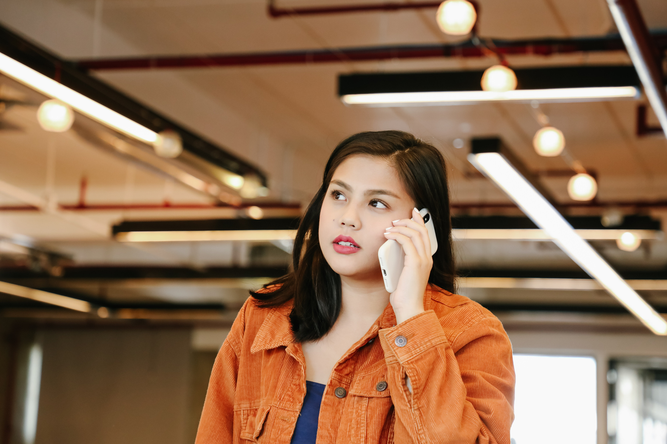
TRAVEL COMPANION WITH TWO FACTOR AUTH.
01

Slide 3

ENSURING TRAVELLER SECURITY
This website aims to ensure all travelers' looking for companions can trust whom they are travelling with.
10

Slide 4

solution
adding an extra security measure when a new user signs into the website for the first time
making use of two factor authentication technology by getting rid of the traditional password use only
Verifying a user every time they log into the travel compppanionn website to constantly ensure identity
Locking suspicious users out of the travel companion website
06

Slide 5
Product
Ensure users security and privacy by use iof two factor authentication method through email OTP
04

Slide 6



Target Market
30% of travelers'
Percentage of people on online travel platforms
80% of all users
Prefer to have a travelling partner
1.4 billion
Amount of money from scams and theft involving travellers and untrustworthy patners.
14

Slide 7
Market Size
Most of the travelers' today are using travel companion websites as they are more efficient and give them a chance to interact meet new people and have interactions

Slide 8
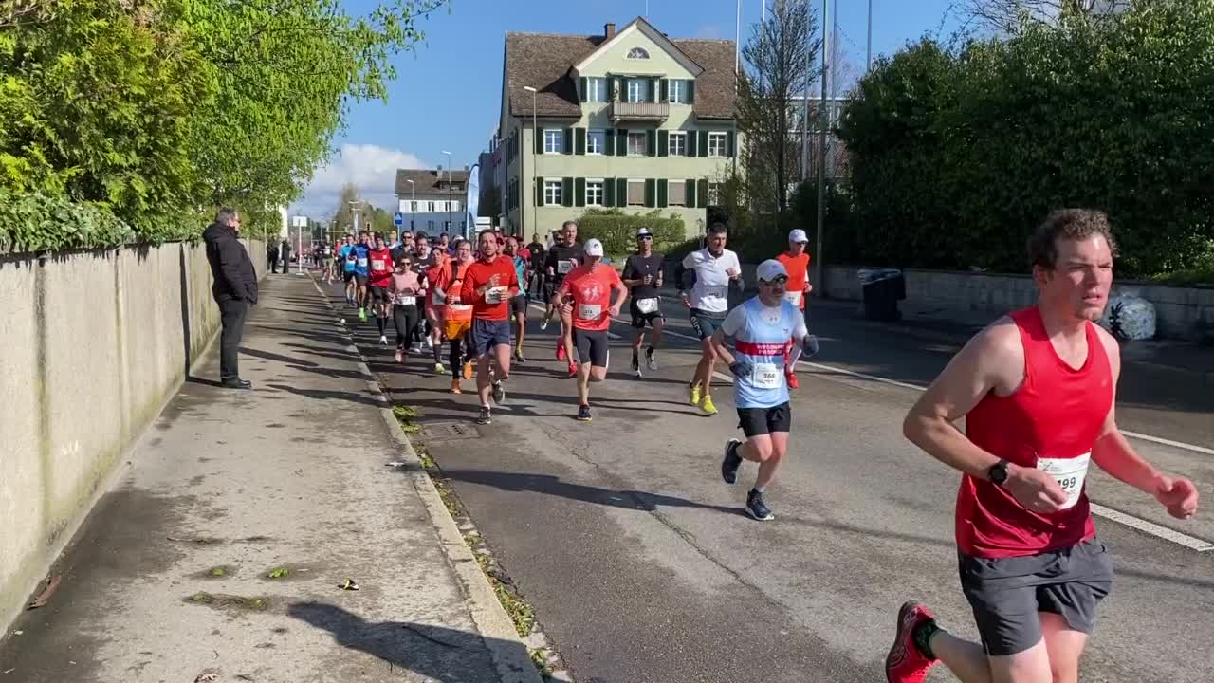
Competitors
Get a friend for life
Workaway
Tripgiraffe
Tourlina
Viavil
Couchsurfing
These sites have a competitive advantage as they have been established for a while thus having acquired many users
23

Slide 9

Competitive Advantage
What makes you unique?
Travel companion is likely to be more desirable as it offer better security while authenticationg users signing into platform
It requires two factor auth every time one has to log into the platform unlike typical sites when two factor authentication is done every once in a while
It offers a unique way to match patners as it considers individuals intrests and matches them to the most matched person
It offers better security as all communications are monitored incase to look for any suspicious conversations that are a threat to travelling patner.

Slide 10
Project Traction
Tasks
Month 1
Month 2
Month 3
Month 4
Month 5
Come up with proposal
research topic for opinion
Acquire team for development
Develop prototype
Test prototype
Pitch idea for funding. Acquire funds
Complete development
Deploy system and register users.
23

Slide 11
Business Model
For users to get most probable match they will have to pay for a premium service. this is how this platform will allow us as the developer to make money. security makes a system more desirable and that is exactly what we will deliver
23

Slide 12
Go To Market
To make our presence known to potential users we will use advertising services. This means we will have to invest so as to be able to buy this service. We will also have influencers use our apps and refer it to others as many people trust in social media celebrities due to the technology age

Slide 13
Social Impact
Our idea brings has an impact on innovation
It shows that there are so many ideas to go about with use of technology
It also contributes to economic growth
It also offers a source of income for individuals

Slide 14
Our Ask
As the developers of the system wre would like to acquire 500k dollars to help fully develop and deploy a working system to people who will rely on security and fuctionality on of the most desirable aspect s of system

Slide 15
Team Members
Fatuma abdi
developer
Alvin kilonzo
developer

Slide 16




Thank you!
Find us on instagramTravelcompanion001
17

